Slide 1

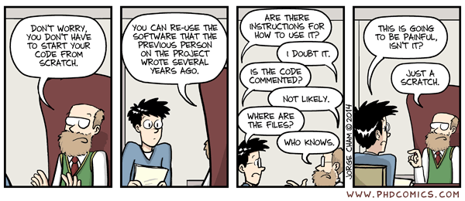



Tools for Reproducible research

Slide 2
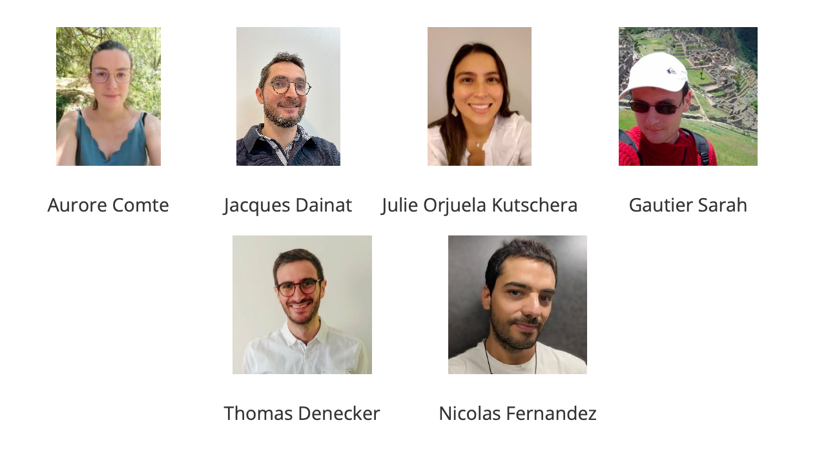

The teachers

Slide 3
Course content
Good practices for working with data
How to use the version control system Git to track changes to code
How to use the package and environment manager Conda
How to use the workflow managers Snakemake and Nextflow
How to generate automated reports using R Markdown
How to use Jupyter notebooks to document your analysis
How to use Docker and Singularity to distribute containerized computational
environments

Slide 4
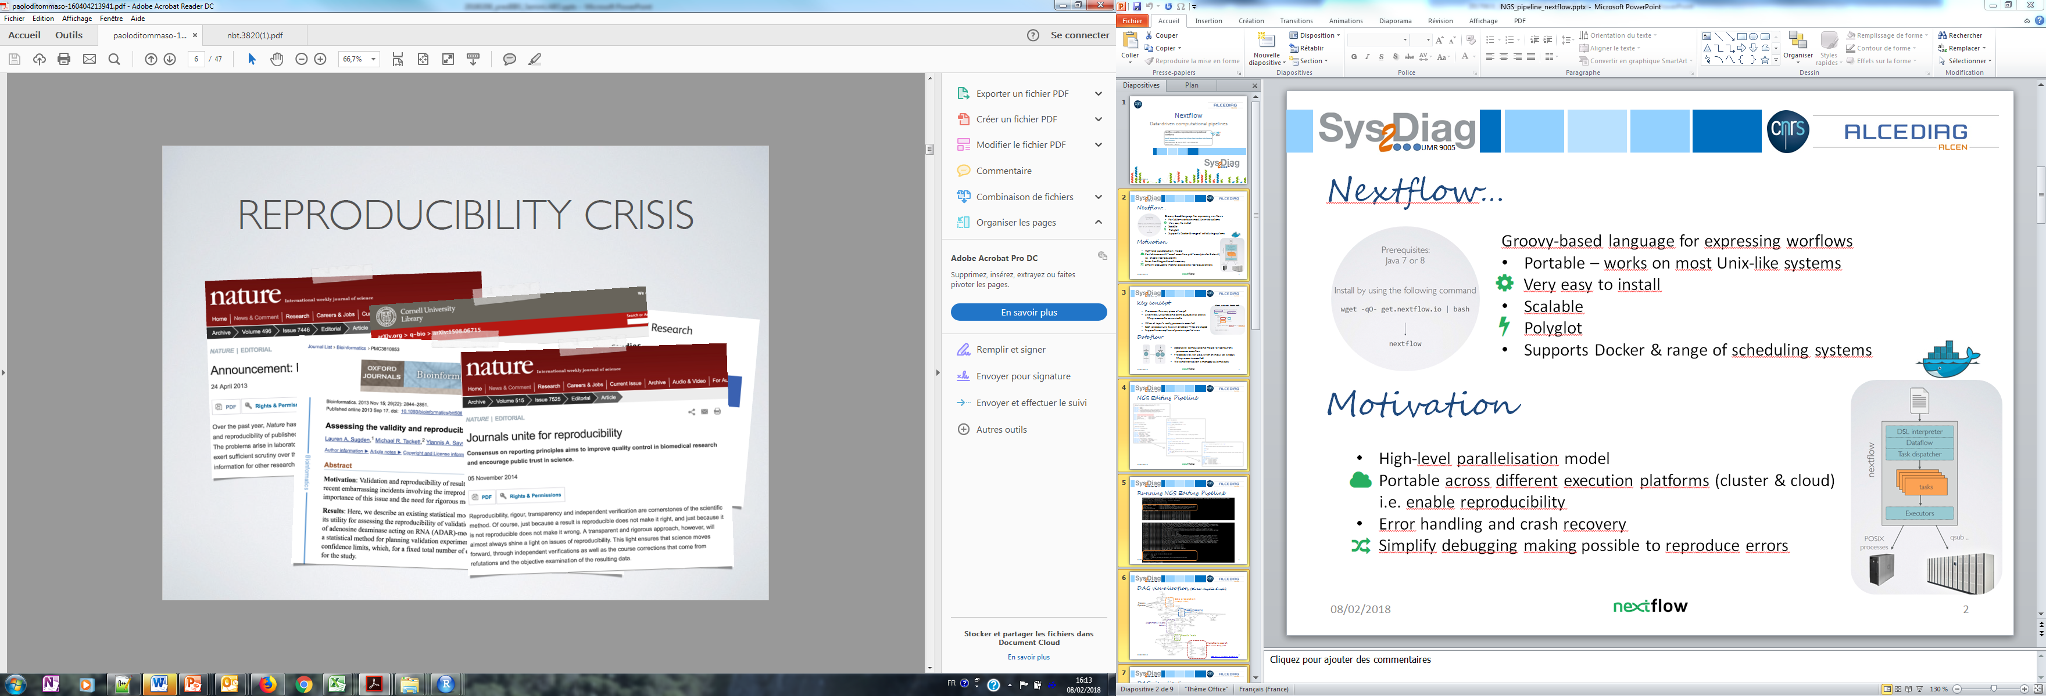
REPRODUCTIBILITY CRISIS
Crisis discovered middle 2000s
Getting bigger early 2010s
Many publications tackle the problem
Notes:
Majeur partie des chercheurs incapable de reproduire resultat d’autrui mais egalement les leurs.

Slide 5
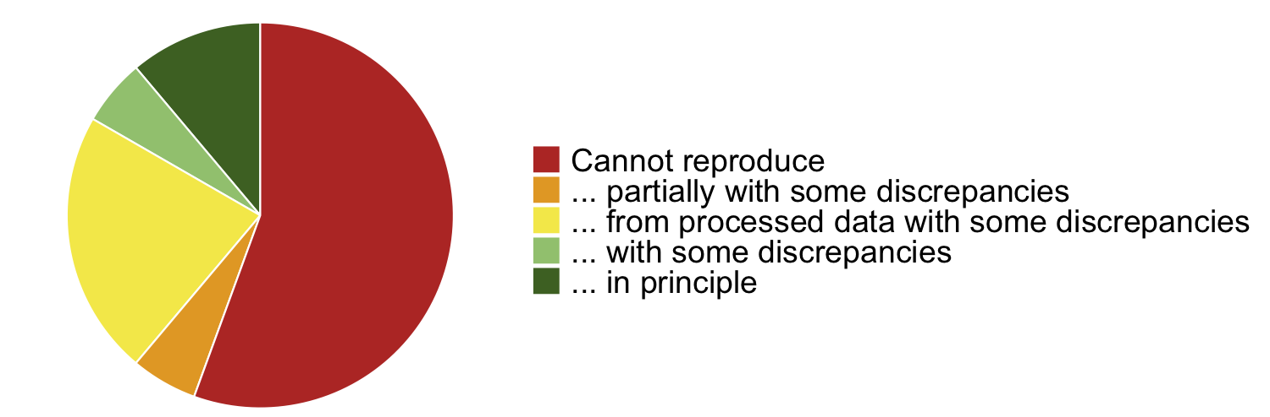
REPRODUCTIBILITY CRISIS
Replication of data analyses in 18 articles on microarray-based gene expression profiling published in Nature Genetics in 2005–2006:
Adopted from Ioannidis et al. "Repeatability of published microarray gene expression analyses", Nature Genetics 41 (2009) doi:10.1038/ng.295

Slide 6
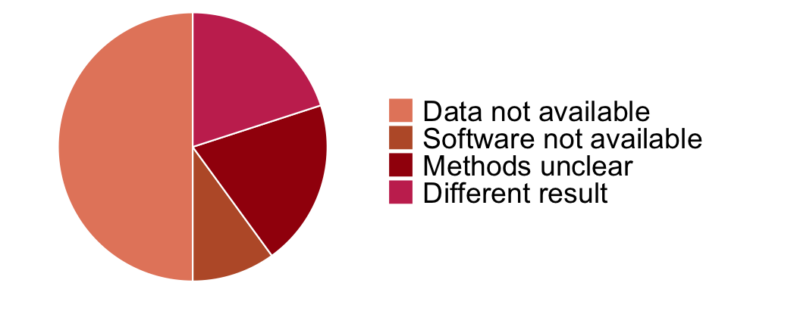
REPRODUCTIBILITY CRISIS
Replication of data analyses in 18 articles on microarray-based gene expression profiling published in Nature Genetics in 2005–2006:
Adopted from Ioannidis et al. "Repeatability of published microarray gene expression analyses", Nature Genetics 41 (2009) doi:10.1038/ng.295

Slide 7
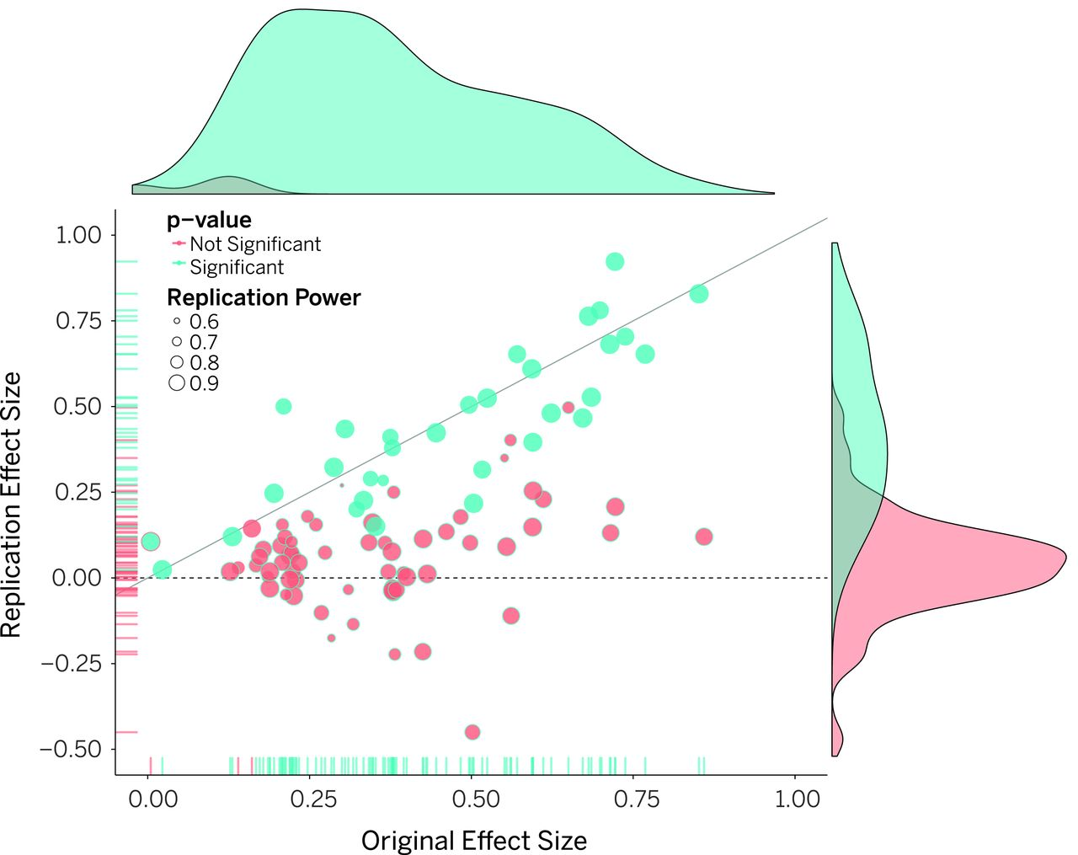
REPRODUCTIBILITY CRISIS
The Reproducibility project set out to replicate 100 experiments published in high-impact psychology journals.*
About one-half to two-thirds of the original findings could not be observed in the replication study.
* Open Science Collaboration. (2015). "Estimating the reproducibility of psychological science". Science. 349

Slide 8
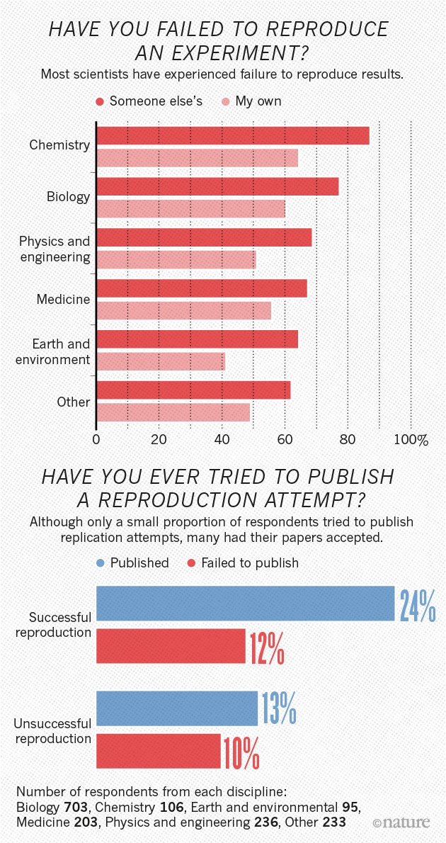
REPRODUCTIBILITY CRISIS
Nature 2016 (https://doi.org/10.1038/533452a)
1,500 scientists lift the lid on reproducibility
A survey revealed that irreproducible experiments are a problem across all domains of science.
More than 70% of researchers have tried and failed to reproduce another scientist's experiments
More than half have failed to reproduce their own experiments.
Notes:
Majeur partie des chercheurs incapable de reproduire resultat d’autrui mais egalement les leurs.

Slide 9
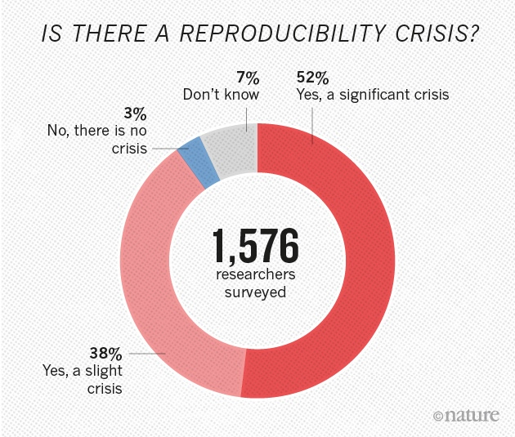
REPRODUCTIBILITY CRISIS
Medicine is among the most affected research fields. A study in Nature found that 47 out of 53 medical research papers focused on cancer research were irreproducible*.
Common features were failure to show all the data and inappropriate use of statistical tests.
* Begley, C. G.; Ellis, L. M. (2012). "Drug development: Raise standards for preclinical cancer research". Nature. 483 (7391): 531–533
Notes:
Majeur partie des chercheurs incapable de reproduire resultat d’autrui mais egalement les leurs.

Slide 10
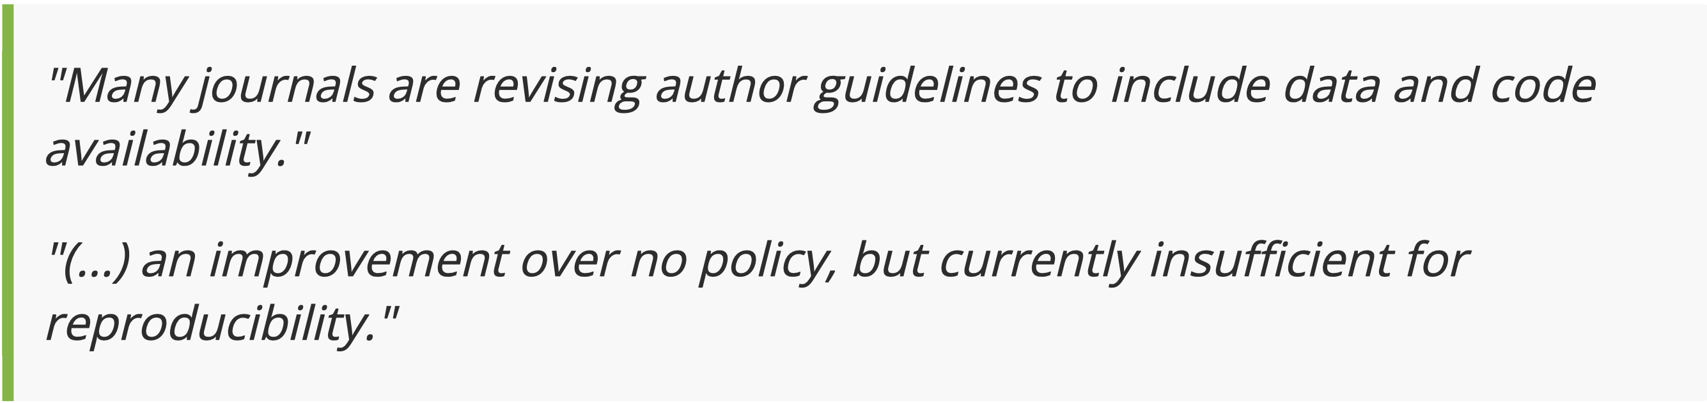
REPRODUCTIBILITY CRISIS
The results of only 26% out of 204 randomly selected papers in the journal Science could be reproduced.*
*Stodden et. al (2018). "An empirical analysis of journal policy effectiveness for computational reproducibility". PNAS. 115 (11): 2584-2589
Notes:
Majeur partie des chercheurs incapable de reproduire resultat d’autrui mais egalement les leurs.

Slide 11
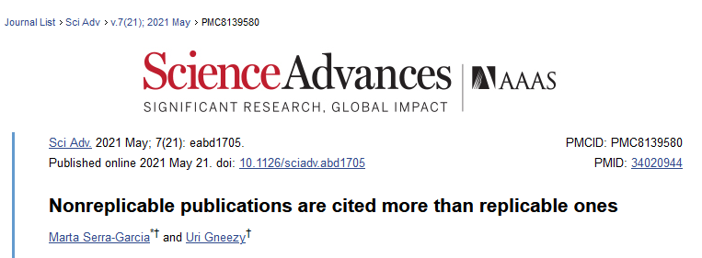
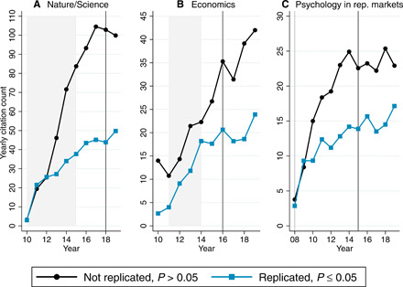
REPRODUCTIBILITY CRISIS
"Remarkably, only 12 percent of post-replication citations of non-replicable findings acknowledge the replication failure"
The average yearly citation count per year for studies that were not replicated.
Notes:
Unexpected consequences: Nonreplicable studies are still used a lot even after shown there where not replicable

Slide 12
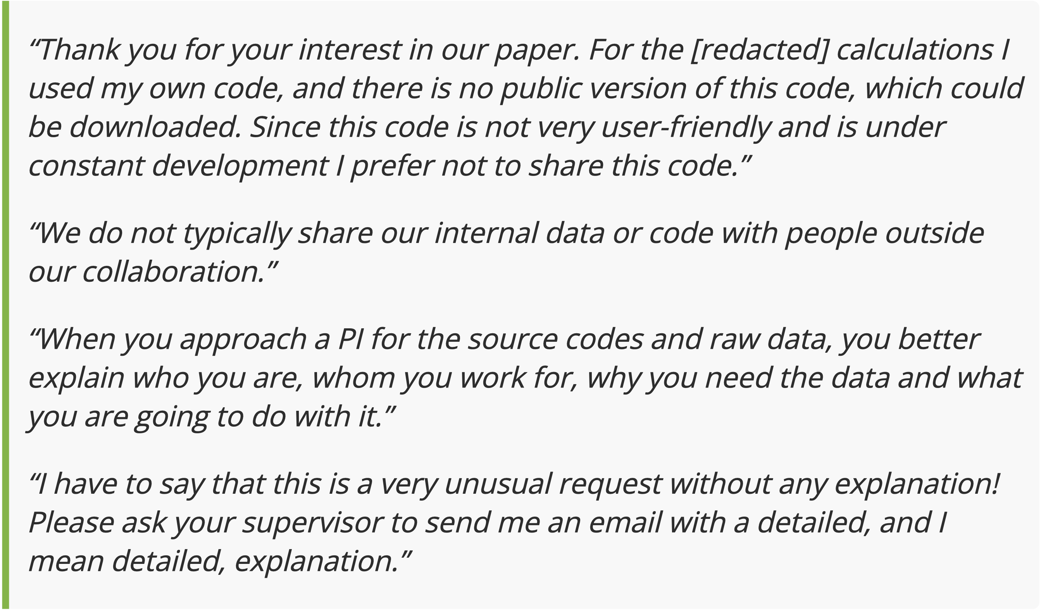
REPRODUCTIBILITY CRISIS
There are many so-called excuses not to work reproducibly:

Slide 13
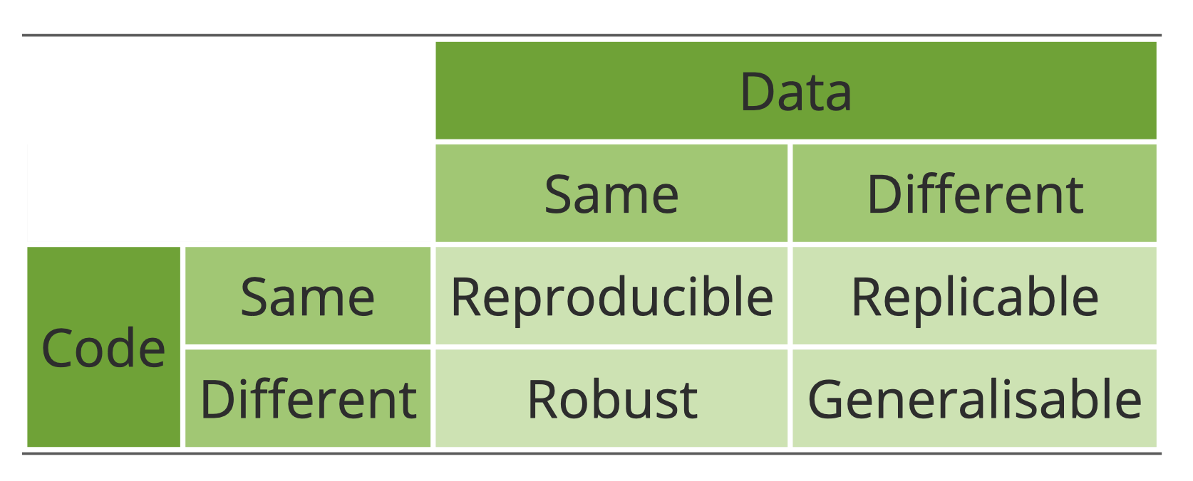
What does reproducible research mean?

Slide 14
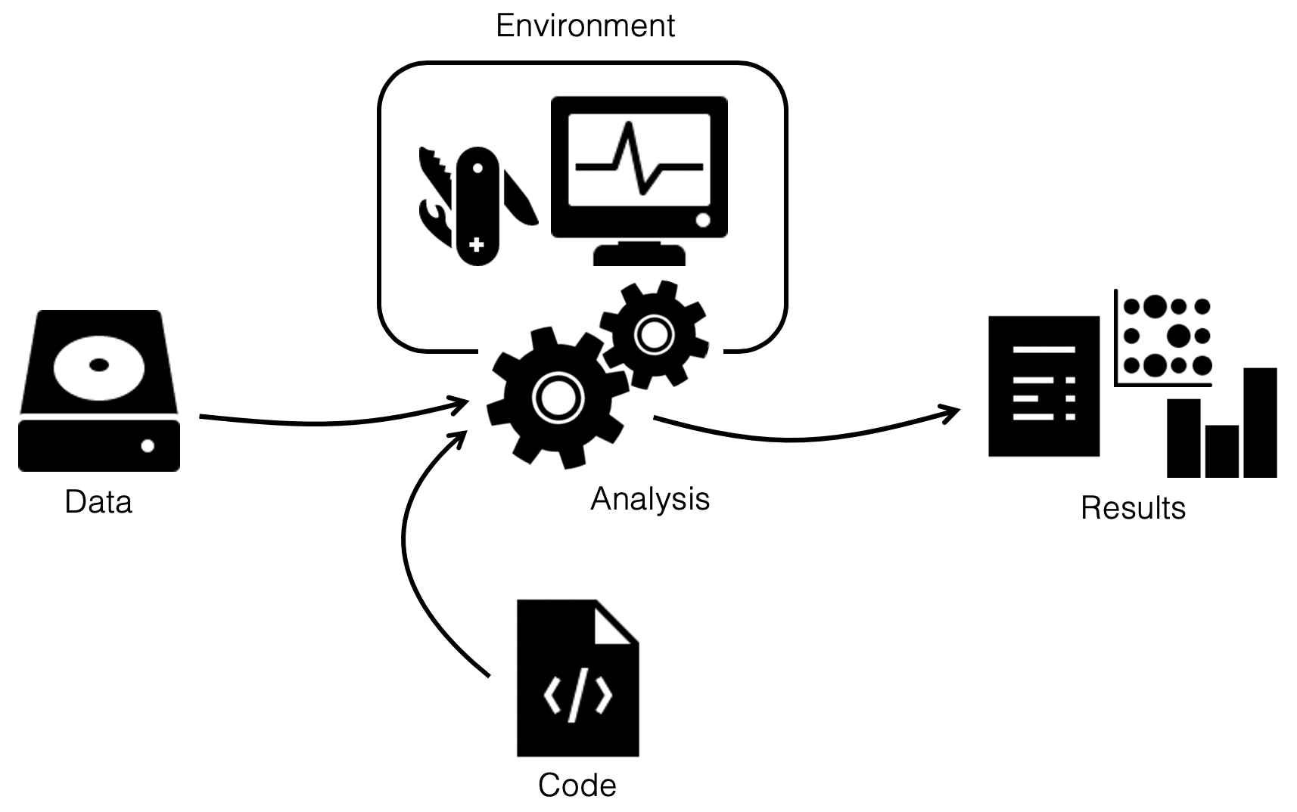
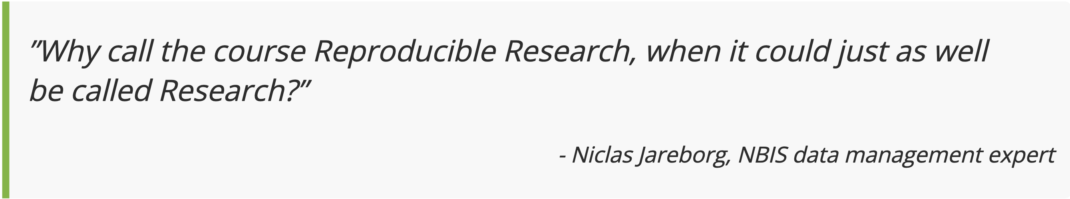
What does reproducible research mean?

Slide 15
How are you handling your data?
Decent
Data available on request
All metadata required for generating the results available

Slide 16
How are you handling your data?
Decent
Data available on request
All metadata required for generating the results available
Data deposited in public repositories
Raw data available in unedited form
If the raw data needed preprocessing, scripts were used rather than modifying it manually
Good

Slide 17
How are you handling your data?
Decent
Data available on request
All metadata required for generating the results available
Data deposited in public repositories
Raw data available in unedited form
If the raw data needed preprocessing, scripts were used rather than modifying it manually
Section in the paper to aid in reproduction
Used non-proprietary and machine-readable formats, e.g. .csv rather than .xls .
Good
Great

Slide 18
How are you handling your code?
Decent
All code for generating results from processed data available on request

Slide 19
How are you handling your data?
Decent
All code for generating results from processed data available on request
All code for generating results from raw data is available
The code is publicly available with timestamps or tags
Good

Slide 20
How are you handling your data?
Decent
All code for generating results from processed data available on request
All code for generating results from raw data is available
The code is publicly available with timestamps or tags
All code for generating results from publicly available raw data is available
Code is documented and contains instructions for reproducing results
Seeds were used and documented for heuristic methods
Good
Great

Slide 21
How are you handling your environnment?
Decent
Key programs used are mentioned in the methods section

Slide 22
How are you handling your environnment?
Decent
Key programs used are mentioned in the methods section
List of all programs used and their respective versions are available
Good

Slide 23
How are you handling your environnment?
Decent
Key programs used are mentioned in the methods section
List of all programs used and their respective versions are available
Instructions for reproducing the environment publicly available
Good
Great

Slide 24
"What's in it for me?"
Before the project
Improved structure and organization
Forced to think about scope and limitations
During the project
Easier to re-run analyses and generate results after updating data, tools, parameters, etc.
Closer interaction between collaborators
Much of the manuscript "writes itself"
After the project
Faster resumption of research by others (or, more likely, your future self), thereby increasing the impact of your work
Increased visibility in the scientific community

Slide 25
Questions?

